Slide 1

Airbnb in New York City Analysis
Group 3
CIS 9650
Linh, Behzad, Ei, Mostafa, Aykut, Jesina
Notes:
Me Linh, Behzad,

Slide 2

Agenda
Introduction
Summary of Dataset
Data Visualization
Statistical Analysis

Slide 3

Introduction

Slide 4

Purpose of Analysis
Airbnb has risen as the main platform for travelers to find affordable accommodation, and transformed the hospitality industry and the way people travel
Our purpose is to study the Airbnb market in New York City, and derive meaningful observations and trend analysis about Airbnb listings in the city
We also aim to identify the best statistical model in predicting Airbnb’s prices using Python

Slide 5
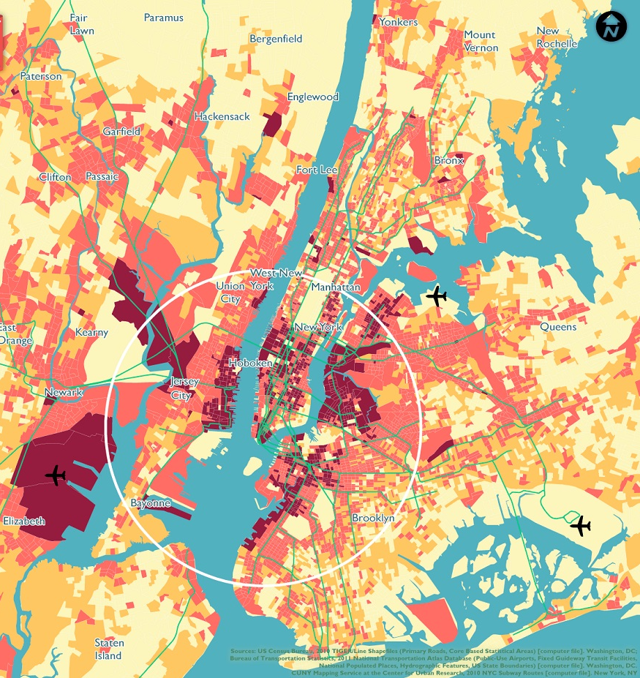
2. Summary of Dataset

Slide 6

Description of Dataset
47906 unique values
16 columns with 16 different variables
Focus on locations, price, room types and reviews

Slide 7

3. Data Visualizations

Slide 8
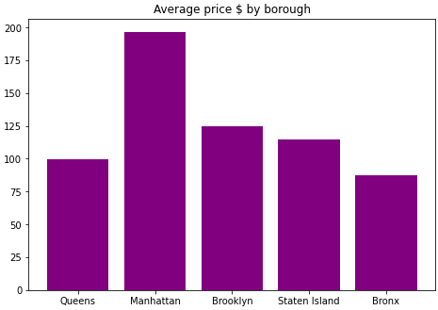
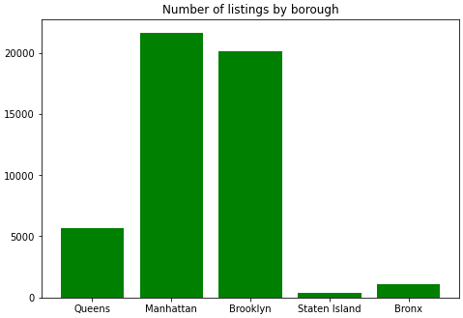
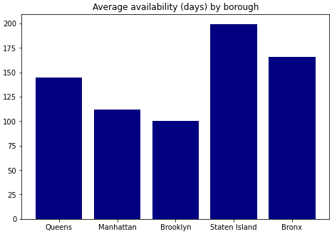
General Observations by Borough

Slide 9
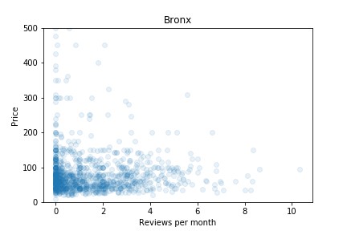
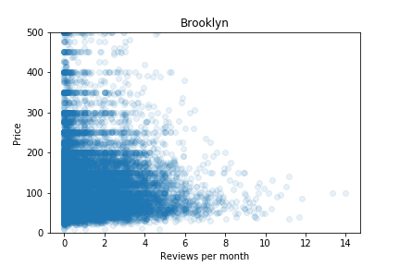
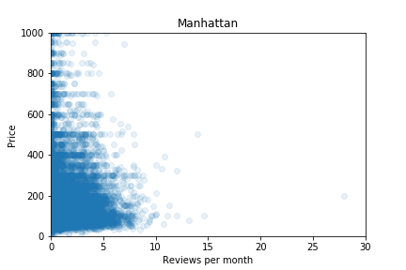
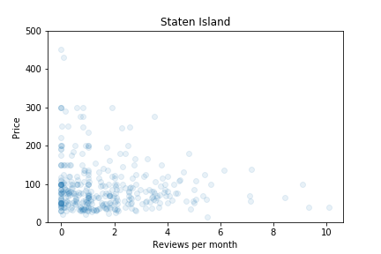
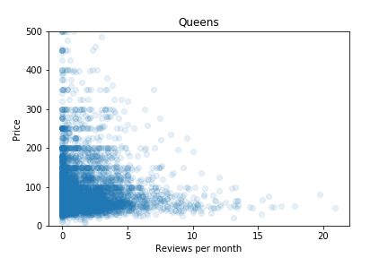
Price vs Number of Reviews Per Month
Notes:
We also plotted scatter plots of numerical variables versus price. Out of the all the plots, we derived two that show meaningful observations. The first one is price vs number of reviews per month. As seen here, most Airbnb properties are concentrated in the lower price zone, with under 5 reviews. The most reviews per month happen in lower-priced properties of under 100 in Brooklyn and Queens, and under 200 for Manhattan.

Slide 10
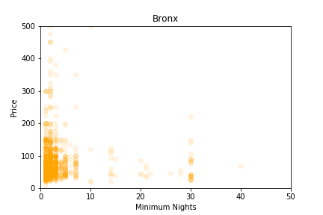
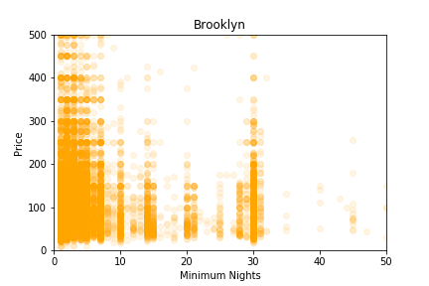
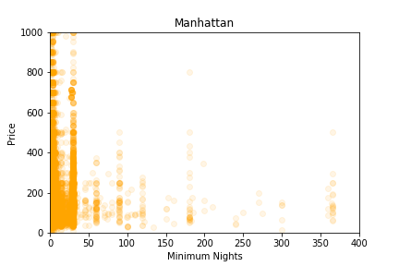
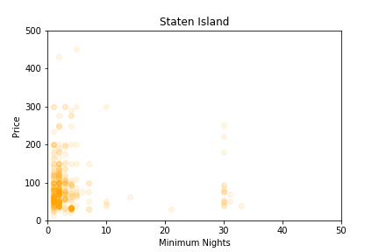
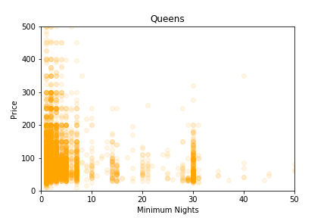
Price vs Minimum Nights
Notes:
The second observation we had is that most properties are concentrated in the lower price zone with a minimum nights of under 10 days. This shows that most listings on Airbnb are short term, however, we also see a second concentration around the 30 minimum nights mark in Brooklyn, Manhanttan and Queens. This means that monthly stays are the second popular after short term.

Slide 11
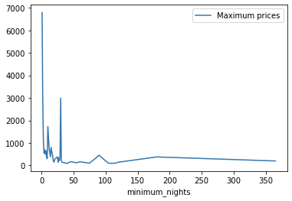
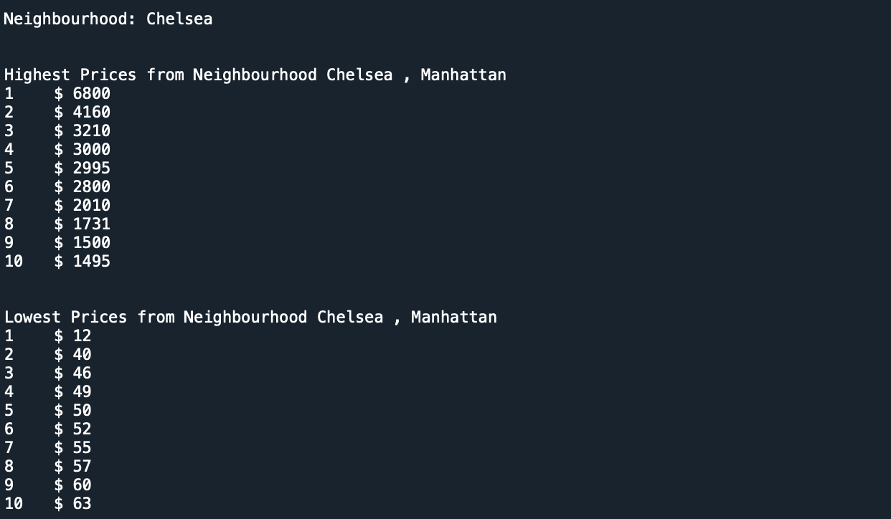
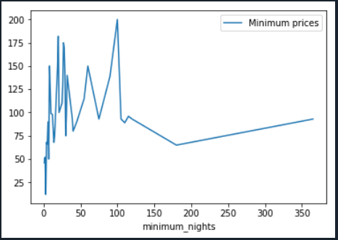
Price by Neighborhood
Notes:
The dataset covers the many neighborhoods of Manhattan, therefore we implement a user input tool, where user can type in a neighborhood in New York, and the 10 highest prices and 10 lowest prices would show, together with two line graphs of all the maximum and minimum prices.

Slide 12
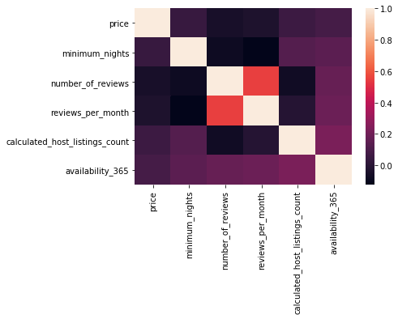
Correlation Matrix

Slide 13

4. Statistical Analysis

Slide 14
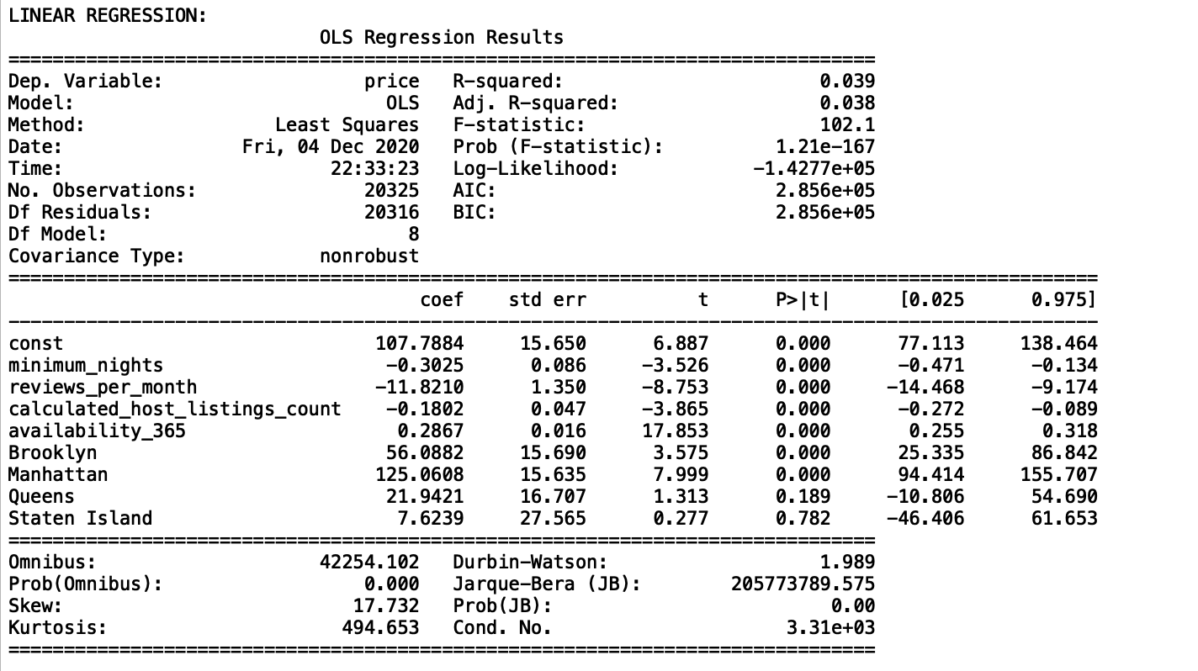
Linear Regression
We did a linear regression analysis to see the effect of the above variables on the price. Although some predictor coefficients are significant but the R-squared value is extremely low (0.039). Only 3.9% of price variability comes from those variables. Therefore the model cannot predict the price. Mean squared error: 92699.09
Notes:
Note that Borough is a categorical variable. It is converted to a dummy variable which is three columns of boolean values.

Slide 15
Regularization
Ridge and Lasso
Train RMSE | 271.95
Train R-Squared | 0.038
Test RSME | 304.46
Test R-Squared | 0.0308
Applying Ridge and Lasso regression as two regularization method improved the Mean Sum of Squares but it did not improve the model over all. Regularization parameter were obtained by 5 fold cross validation. (1 for Ridge and 0.01 for Lasso)

Slide 16
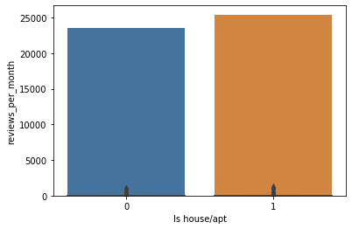
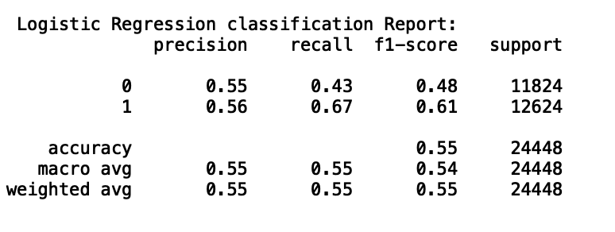
Predict Type of a Property
Binary Classification with Logistic Regression and Random Forest
We would like to see if “Latitude”, “Longitude”, “Minimum nights” “Reviews per month”, “Listing counts” and “Availability” can predict if the property is the entire house/apartment or it is a room.
Logistic Regression Confusion Matrix
5060 (True Negative) | 6764 (False Positive)
4149 (False Negative) | 8475 (True Positive)
Random Forest Confusion Matrix
8049 (True Negative) | 3775 (False Positive)
3472 (False Negative) | 9152 (True Positive)
Accuracy Score
Logistic Regression | 55%
Random Forest | 69%

Slide 17
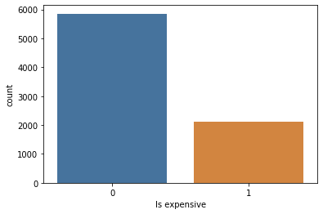
Binary Classification with Random Forest
We would like to see if “Minimum nights” “Reviews per month”, “Listing counts” and “Availability” can predict if the price of a private room in Manhattan is above average or below average by applying Random Forest method. 70% of the data is used for the train and 30% for the test set
Random Forest Confusion Matrix
 | Predicted False | Predicted True
Actual False | 1564 | 165
Actual True | 474 | 148
Standardized Confusion Matrix
0.66 | 0.07
0.20 | 0.06
The score for Random Forest is 0.72. That mean 72% of time it predict correctly whether a room in Manhattan is expensive or not compared to the mean.

Slide 18


Thank you!

